Slide 1
Installation , uninstallation Climsoft and Link Climsoft with Microsoft Access
By Emmanuel Qurino

Slide 2
Outline
Introduction
Install Climsoft
Link Climsoft with Microsoft Access
Uninstall Climsoft

Slide 3
Introduction
Definition of " CDMS " : ( Climate Data Management System )
Tool to acquire, store, monitor, preserve, control and manage data; Allows data access and offers various products.
Definition of " CDMS installation " :
hardware and software in place, CDMS system running;

Slide 4
Install Climsoft
Know the size of the computer because the Climsoft need size two Gb.
Open Cimsoft 2014, double click on distribution floder.

Slide 6
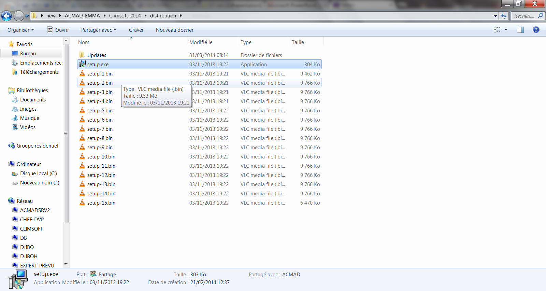
Sources of Climsoft setup

Slide 7
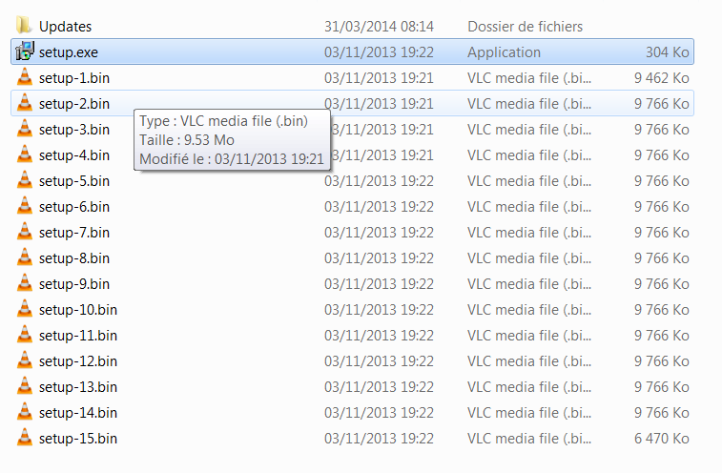
Double click to start installing

Slide 8
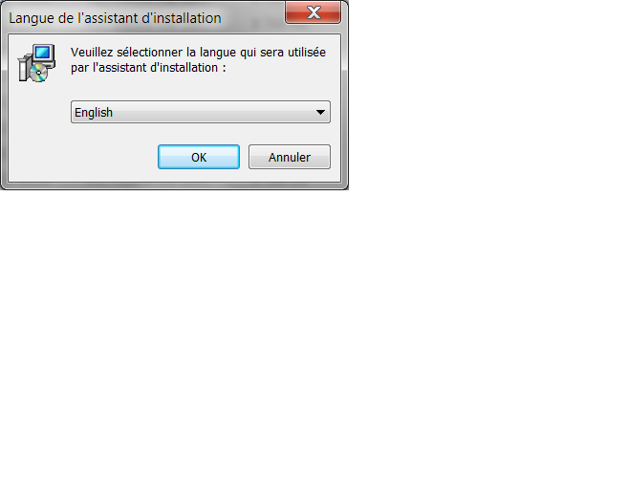
Change the language user need and click Ok

Slide 9
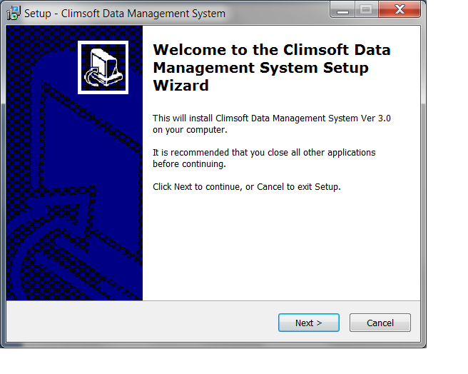
Click on

Slide 10
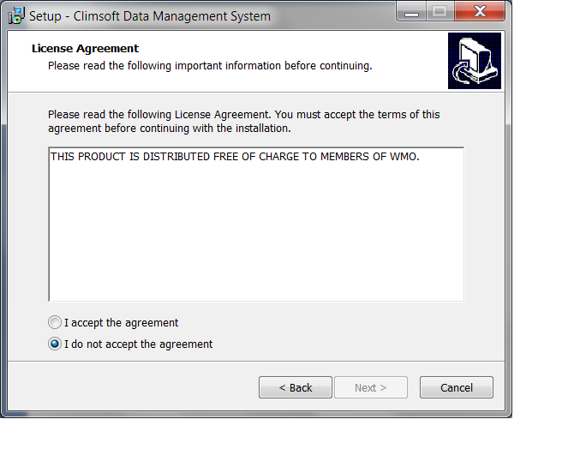
Select I accept the agreement

Slide 11
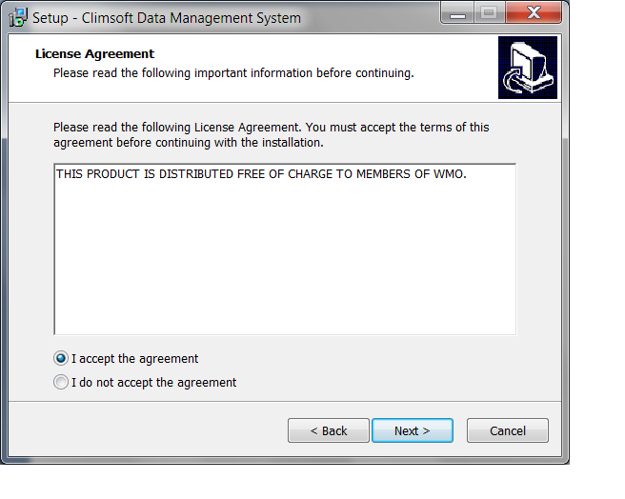
Click on

Slide 12
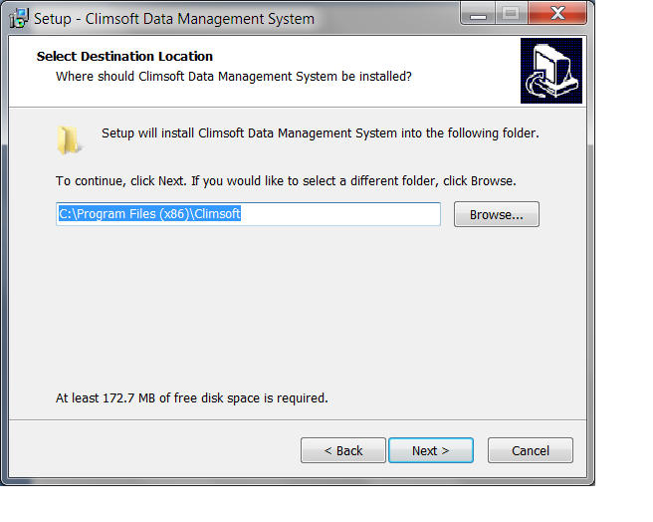
Click on

Slide 13
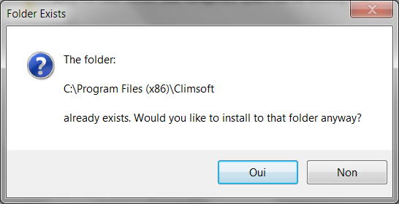
Click on

Slide 14
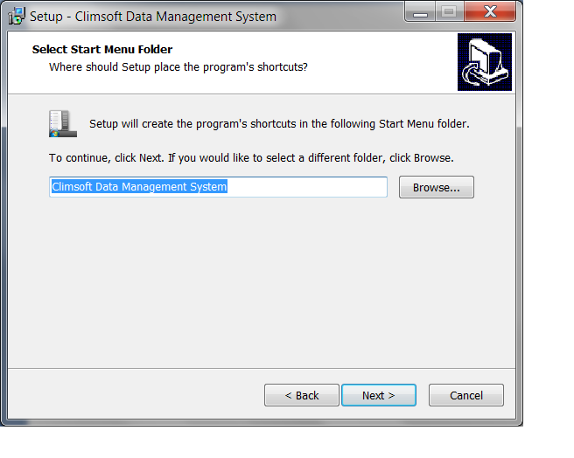
Click on

Slide 15
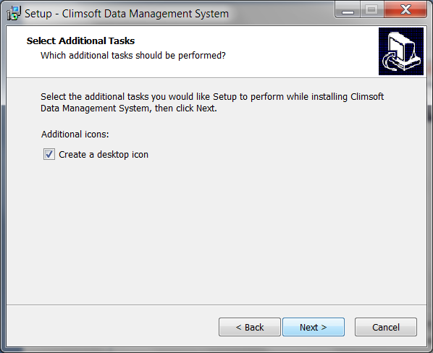
Click on

Slide 16
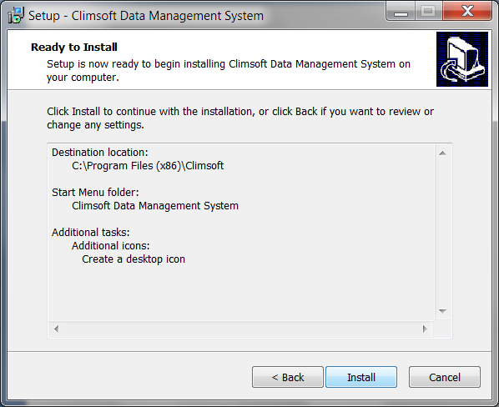
Click on

Slide 17
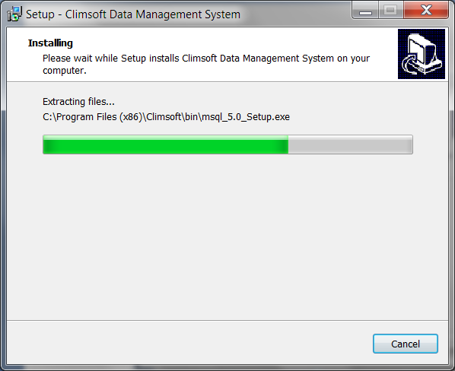
Now installing Climsoft

Slide 18
Click on

Slide 19
Click on

Slide 20
Click on
Climsoft now successfully install on your computer

Slide 21
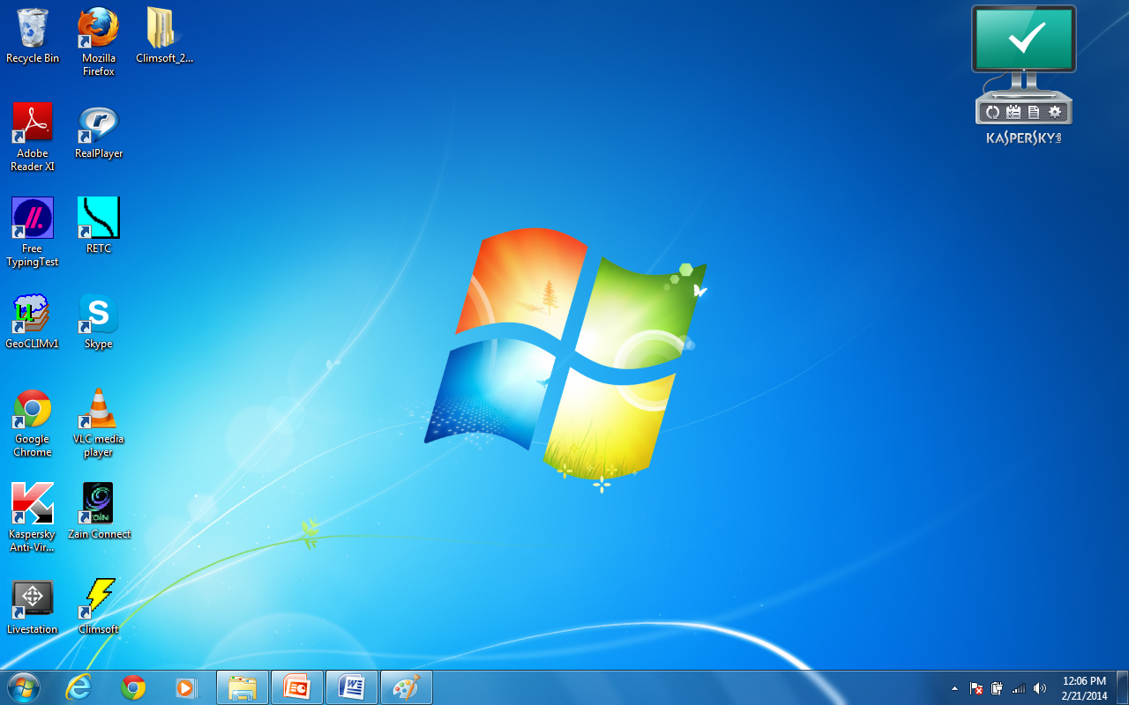
Climsoft software icon

Slide 22
How to link Climsoft with Microsoft Access

Slide 23
Double click on climsoft icon

Slide 24
Click on

Slide 25
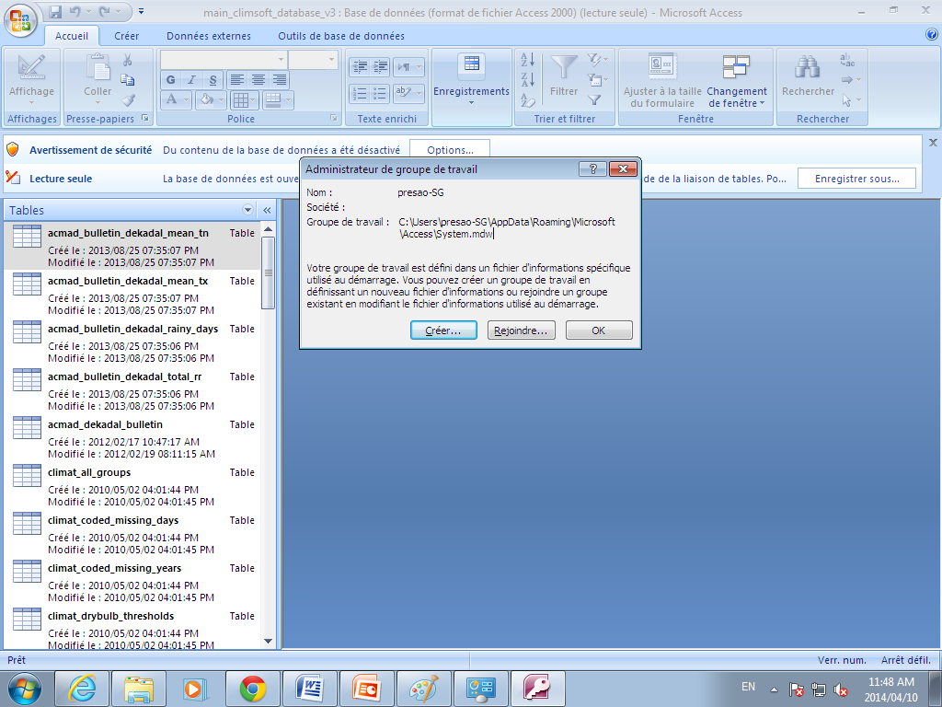
Click on

Slide 26
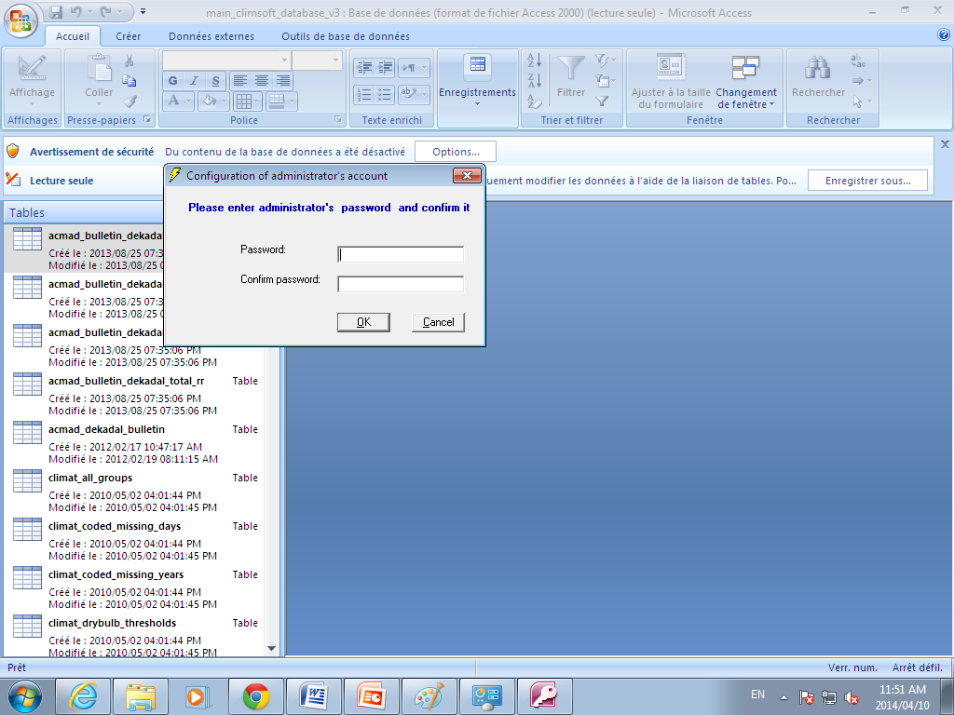
Write your own Climsoft password and
Confirm password then
Click OK

Slide 27
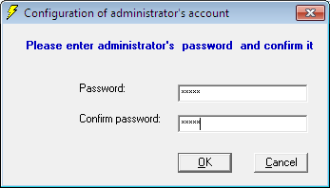
Write your own Climsoft password and Confirm password then Click OK

Slide 28
Repeat password and click on Oui

Slide 29
Now Climsoft successfully link to Microsoft Access

Slide 30
UNINSTALL CLIMSOFT
If Climsoft was pervious install in your computer, uninstall it and install new Climsoft.

Slide 31
The first step click Star menue

Slide 32
Double click on control pannel

Slide 33
Double click on programmmes

Slide 34
Double Click on

Slide 35
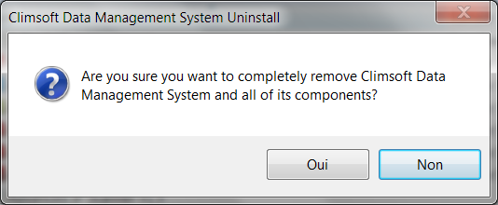
Click on Oui, Climsoft now finished uninstalling and Climsoft icon disseppear on the screen.
Click on

Slide 36
Befor you install the new Climsoft you must get rid of anything in relatation to pervious climsoft

Slide 37
Go to local disk (c)

Slide 38
To folder system32 Inside the local Dick c

Slide 39
To windows inside system 32

Slide 40
Here you can found the first folder we need to deleted

Slide 41
Now we can deleted according in the figure

Slide 42
The step of second folder we need to deleted

Slide 43
To programme file

Slide 44
Delete this file called Climsoft inside the programme file
Delect this ( climsoft file)

Slide 45
Now we can deleted according in the figure

Slide 46
THANK YOU

